Slide 1
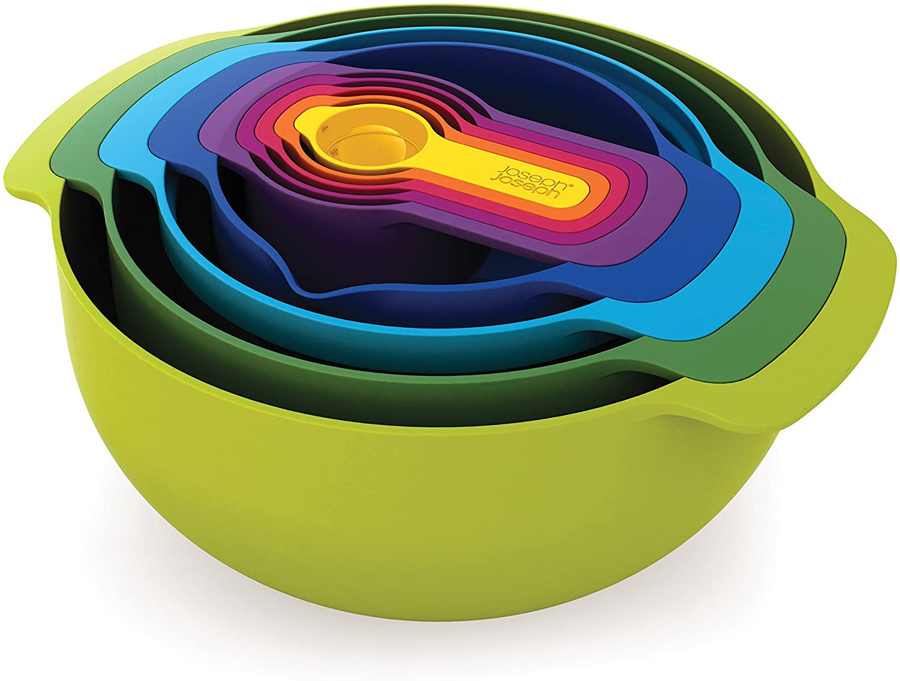
nat5 Design & Manufacture
Design Factors

Slide 2


Learning intentions & success criteria
Learning Intentions
Understand what is meant by a design factors
Learn about the different design factors in relation to designing a product
Success Criteria
I can explain what is meant by a design factor
I can give an example of a design factor and explain what is involved in assessing products

Slide 3
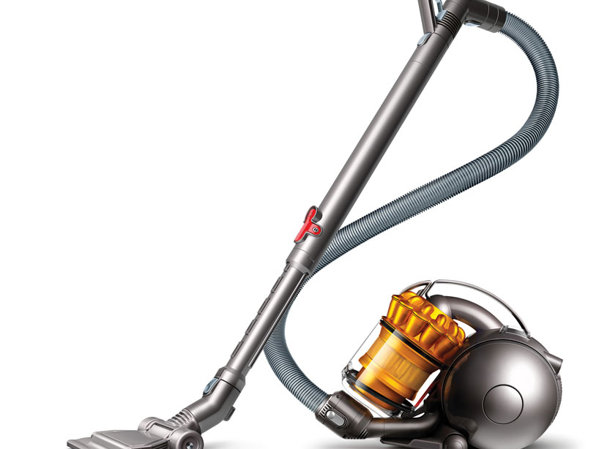
Design analysis
Product analysis is the process of identifying, looking at or disassembling a product and identifying its main features.
The aim is to understand more about the product and improve it in the future.
Many design factors influence the development of a product.
The following slide is a spider diagram of the design factors you are expected to know in S3.

Slide 4
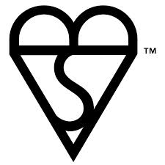
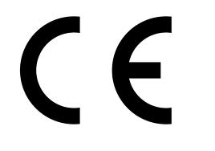
Material
Fitness for
Purpose (what it’s
designed to do
Primary
Secondary
Aesthetics
Manufacture Method
Cost
Strength
Shape
Colour
Texture
Pattern
Form
Proportion
Function
Environment
Recycling
Environmental Impact
Energy
Waste
Design Factors
Ergonomics
Physiology
Psychology
Anthropometrics
Performance
Durability (life expectancy)
Ease of Maintenance
Ease of Use
Safety
Market
e.g. no sharp edges
Who will be
buying the product

Slide 5
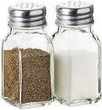
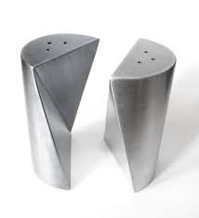
Function
A product’s function is the job it’s designed to do.
Without a function a product is just an object – it would have no purpose.
Example: salt and pepper dispenser.
Function: to apply salt and pepper to food in controlled quantities.

Slide 6
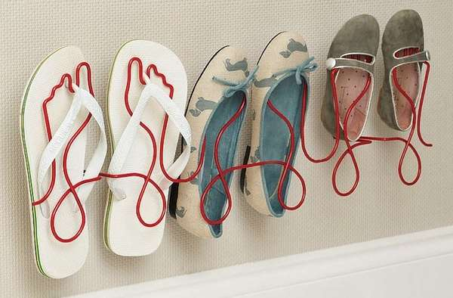
Primary and secondary function
The PRIMARY function of a product is the main operation a product performs. For example:
  A clock displays the time.
  A shoe rack holds shoes.
The SECONDARY function of a product is another operation a product can perform. For example:
  A camera in a phone (functional)
  Aesthetically improves the environment it is placed in (subtle)
  Similarly, a shoe rack being more attractive to look at.

Slide 7
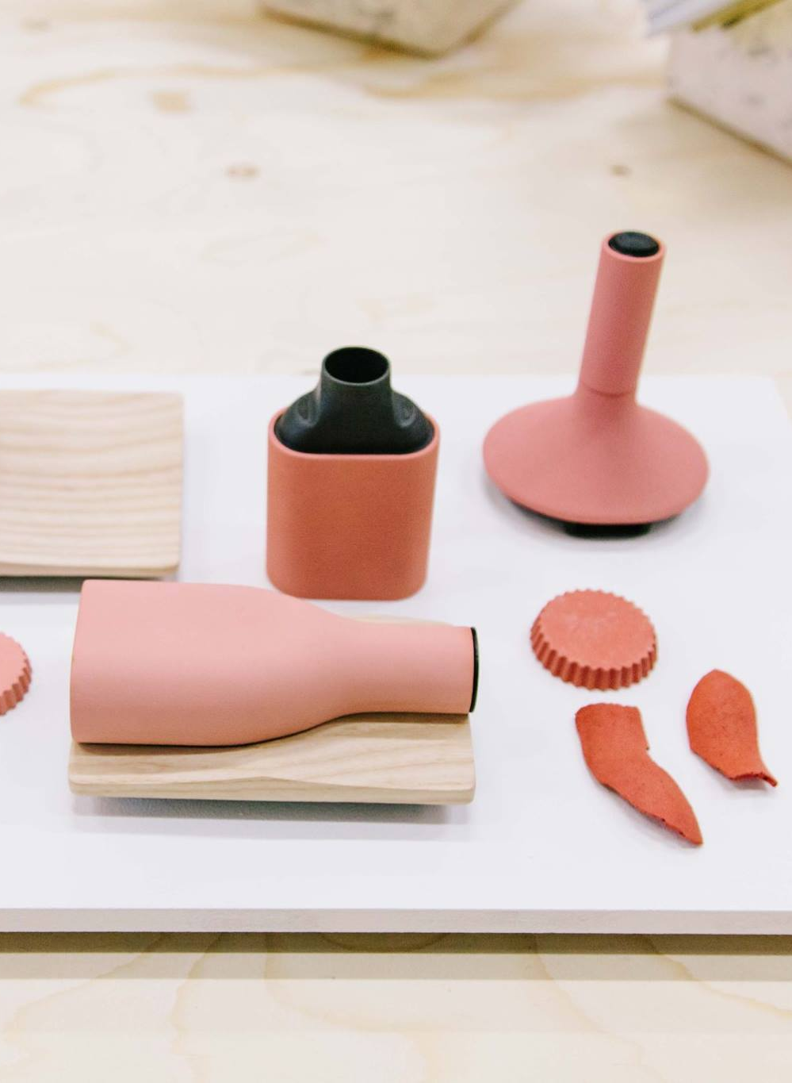
aesthetics
Aesthetics is all about how the product looks and how it feels.
Within the aesthetics design factors, we can break it down further by looking at the following:
  Colour and Shape
  Harmony
  Texture
  Contrast
  Proportion

Slide 8
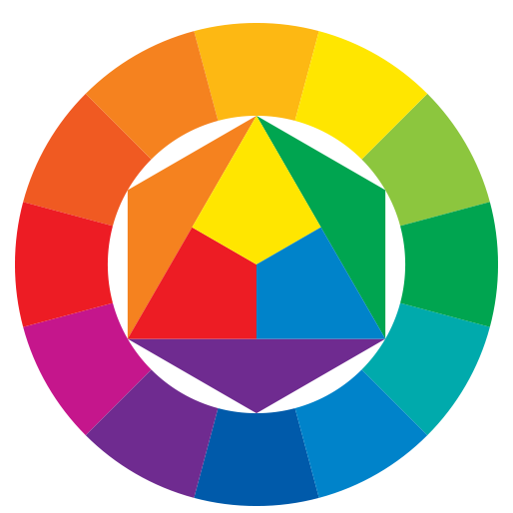
Aesthetics colour and shape
The two aesthetic properties that are easiest to understand.
Both colour and shape can be used to create contrast or harmony.
Colour can be used to target specific markets i.e. bright colours would be used for children's toys, sophisticated colouring for high class products and so on.

Slide 9
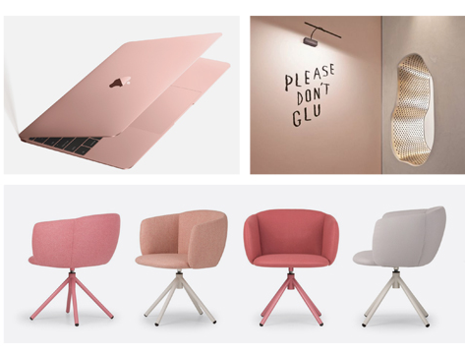
Aesthetics harmony
This is where parts of a design work well together or the design fits in with a specific environment
It creates a sense of peace of relaxation.
Simples shapes and colours that work well
together should be used to achieve this.

Slide 10
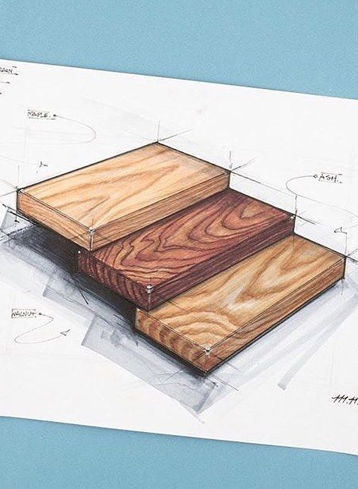
Aesthetics texture
Different textures can makes designs look more stylish or interesting.
Effects such as glass, concrete, wood grain, hard, soft, glossy (shine), matt (flat dull colour) and so on.

Slide 11
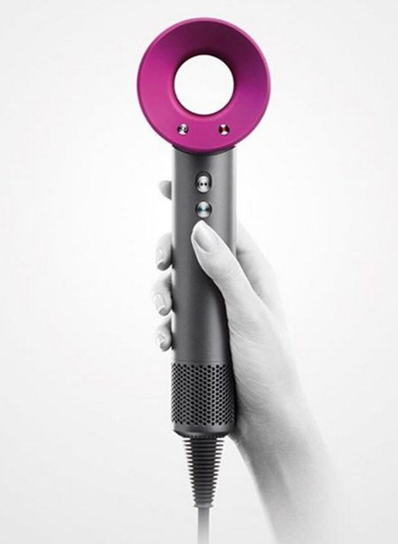
Aesthetics contrast
The opposite of harmony where designs are made to stand out and be bold.
This can sometimes make a design more eye-catching.
Contrast can be created using colours which are opposite each other on the colour wheel, circle and square shapes in a design, large and small, etc.

Slide 12
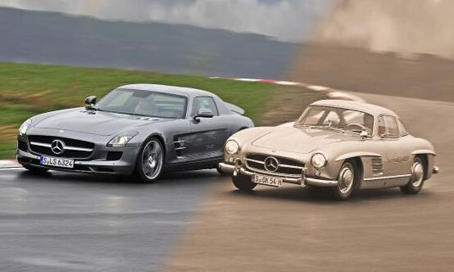
Aesthetics proportion
Small changes to the proportion of a shape can make it look more elegant, classy, stable or sleek.
This example of a classic Mercedes and a modern series shows how simple changes to shape can make designs more
modern, sleek and elegant.

Slide 13
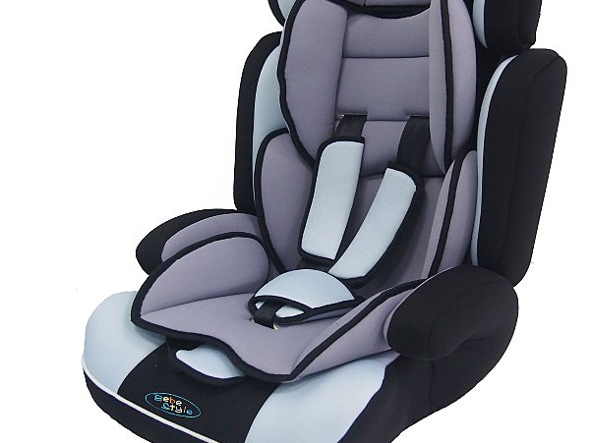
Safety why is it important?
Unsafe products have the potential to cause harm through injury and legislation forbids or restricts their sale. All products are required by law, to meet safety standards, and cannot be sold if they do not meet those standards.
Products will often display symbols to show compliance with safety legislation. If, after being sold, a product is found to be unsafe, the product would be recalled and some form of compensation made to the consumer. Recalling a product is very expensive for a company to do.
Safety is also seen as a major selling point for many products. For example, cars are often advertised by highlighting their safety features. A consumer is more likely to buy a product which has additional safety features.
Many products are created to fulfil a specific safety need. For example child seats for cars, or bicycle helmets are created to protect the user in the case of an accident. Designing safety products is an example of niche marketing.

Slide 14
Safety how can I research and evaluate product safety?
All products sold must pass safety standards, and many will have symbols on them which show the consumer that they have been approved by the relevant organisation.
These symbols are often found on a sticker or moulded onto a product, or printed in the product’s instructions.
British Standards Institute (BSI)
The BSI set and check standards for all products sold in Britain. Products which meet the standards are awarded the BSI Kitemark.
European Community
The CE symbol indicates that the product has met
European regulations and can be sold across Europe.

Slide 15
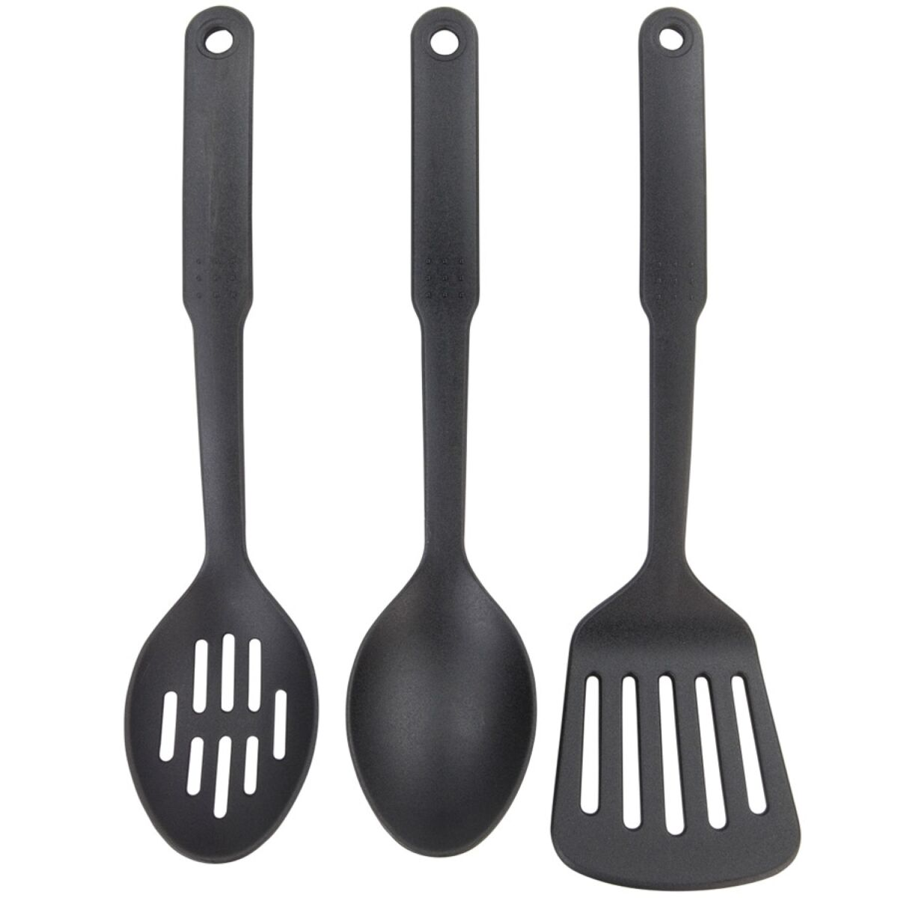
performance
When looking at the Performance of a product it is important that we consider the following issues:
  Durability
  Ease of maintenance
  Strength
  Ease of Use

Slide 16
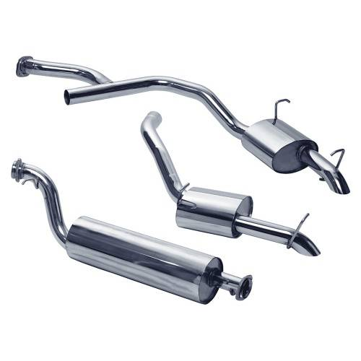
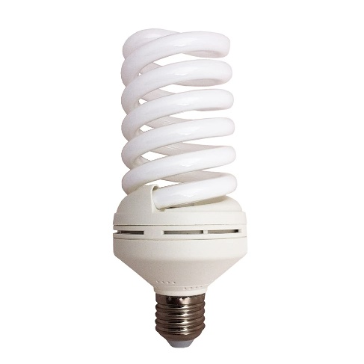
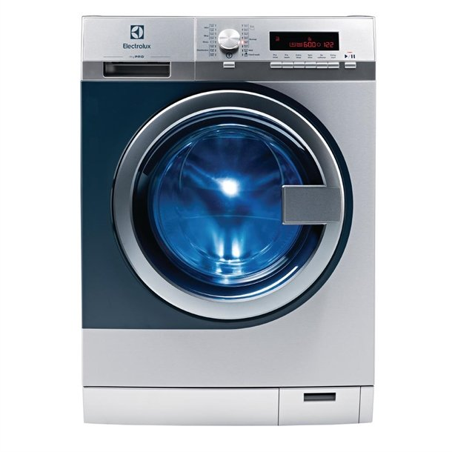
Performance durability
Example 1. A car exhaust is normally made from mild steel which will eventually rust, and need replaced after several years. But the exhaust could be manufactured in Stainless steel which will last a great deal longer but will be more expensive to purchase and will mean that the manufacturers will not sell as may spares.
Example 2 Traditional Light bulbs are expected to last no more than six months in normal use. But new low energy light bulbs which are more expensive can last for years.
Example 3 Washing machines are designed to be replaced after about six years, this allows the manufacturer to constantly sell new models, bringing in more business by continuing to satisfy the buyer’s desire to have the latest, most fashionable model.
Durability is the life expectancy of a product, or how long it is expected to last.
This is decided by the materials that the product is made from and Planned obsolescence.
Planned obsolescence is the usable lifespan that a product has before new advances in technology, fashion or worn parts means that it is no longer desirable to keep the product functioning.

Slide 17
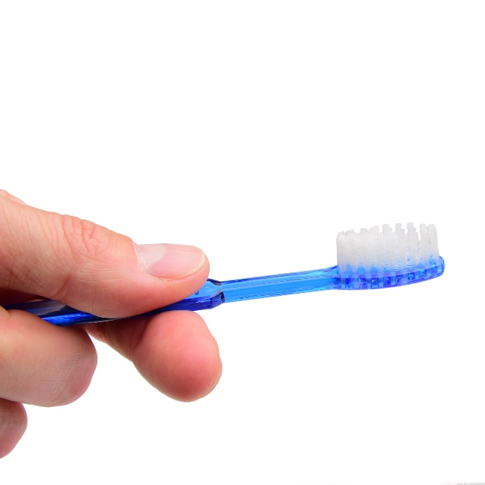
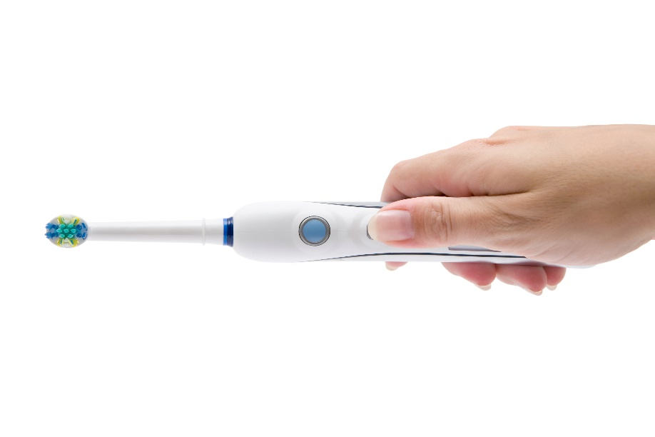
Performance ease of maintenance
Ease of Maintenance is how difficult it is for a user to keep a product in good working order throughout its life.
A cheaper product is probably intended to be thrown away after use and will need no maintenance.
A more expensive product is likely to last much longer and will require periodic maintenance to keep it in good order.
The complexity of a product will have a direct effect on the amount of maintenance required. A very complex product like a car will require a great deal of maintenance in its lifetime, from the regular servicing of the engine to ensure oil and water levels are correct to the replacement of worn parts like brake disks to prolong the life of the car.
These disposable toothbrushes are
designed to be thrown away once the
heads are worn out. There is no design
for ease of maintenance required and
their price is fairly low.
The oral-B electric toothbrush is designed to have a replaceable head, so that a consumer does not have to buy a whole new toothbrush each time the head wears out. This increases the initial cost of the product as there are additional components required to enable the head to join to the body, but allows the main body of the toothbrush to be used for a long time. Consumers would not buy the Oral-B at all if they needed to replace the whole product as often as they replace a fixed head.

Slide 18
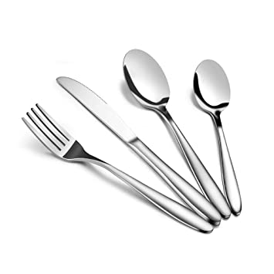
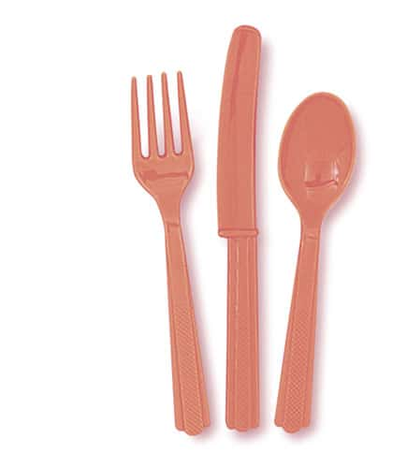
Performance materials
When coming up with a design for a product we must consider how many are to be produced, who the target market is, what the product is going to be used for, how and where it is to be used. When we have established all of this it becomes easier to decide which materials would be most suitable for the job.
In order to decide which materials to use we must have an idea of what properties we wish them to have.
For instance, a car wing-mirror must be waterproof, resistant to sunlight, impact resistant, chemically resistant and corrosion resistant. On top of this, the shape of the wing mirror must be able to be formed easily as it is a ‘mass produced’ product.
Choice of Materials will have a direct effect on several aspects of the design, including:
  The manufacturing processes that can be used
  The finishes that can be applied
  The disposal of a product at the end of its life
  The cost of the product
  The lifespan of the product
  The product’s performance in terms of strength, weight.
Cutlery made from stainless steel will be long lasting, corrosion resistant,
expensive and will require costly die cast moulds to produce.
Cutlery made from HIPS will be cheap, light, easily broken,
recyclable, will come in a range
of colours, and will require
injection moulding machinery to produce.

Slide 19

ergonomics
The Ergonomics of a product are concerned with the human interaction with it (body and mind).
We will look at the three topics covered in ergonomics:
  Anthropometrics
  Physiology
  Psychology

Slide 20
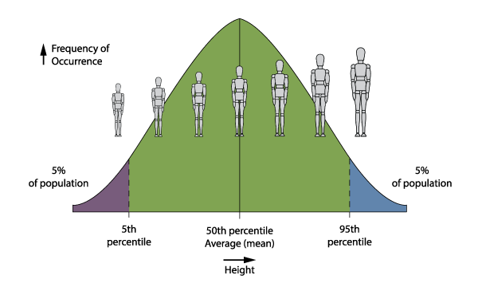
ergonomics anthropometrics
Anthropometrics concerns the measurements of the human body. A survey is made of around 1 million people between the ages of about 19 – 65 with every relevant part of the body being recorded.
This information is then compiled to make charts called ‘Anthropometric data tables’ which show us what the smallest, largest and average sizes are. This information is very important when designing for people.
From the tables, designers only use information from the 5th to the 95th percentile. This is because they want to be able to cater for as many people as possible and the people from the 0 – 5 percentile and those from the 96th – 100th percentile are seen as being too extreme, i.e. too small and too big.

Slide 21

ergonomics physiology
Physiology is concerned with the study of the systems within the human body, their responses, limitations and capabilities. Designers may have to consider strength, fatigue, muscle control, colour perception, hearing capabilities and other features when designing for people.
For example, when designing the braking system for a car it must be able to be operated effectively by all drivers. Anthropometric information must therefore be gathered about the strength of people’s legs, as well as on lever and hydraulic systems designed to suit the forces required.
The legs are used for the repetitive tasks in driving such as applying the brakes and the clutch because they are much stronger than arms and hands, which are more nimble and better suited to finer controls like using the steering wheel or adjusting the volume on the radio.

Slide 22

ergonomics psychology
Psychology is concerned with the human mind and the way it works. Human senses (sight, hearing, smell, touch, taste) are continually being stimulated and send messages to the brain where they are processed. Some signals are ignored while others provoke a rapid response, some are interpreted accurately whereas others may be misunderstood.
Understanding some of these processes involved in the interpretation activity proves to be vital in the development of a good design.
An example of psychology being taken into consideration at the design stage is a computer/laptop keyboard. When you press the buttons, you ‘know’ that you have pressed it because it makes a ‘click’ sound or it physically moves and bounces back. The keyboard does not need to do this to operate, but these features are included because it makes it easier for us to use.

Slide 23

Market
Market is everything to do with who will buy the product, where/when it will be sold, how much it will cost etc.
Often referred to as “Target Market” this is the group of people who the product will be aimed at. The target Market is influenced by:
  Age
  Geographical location
  Income
  Interests
  Lifestyle
  Cultural
  Religion
  Need/wants of consumers
  Current trends

Slide 24
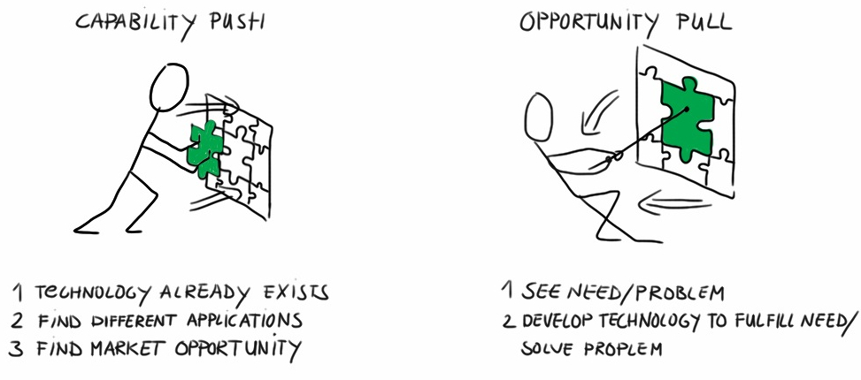
Market
- Market Pull & Technology push
Market Pull, Technology Push:
Designers identify the opportunity to develop new products based on technology push or market pull.

Slide 25

Market
- brands
A brand is much more than simply a name or a logo
A brand consists of all the impressions and experiences associated with a company or product.

Slide 26

Market
- brands
Customers can relate to a brand on a rational and on an emotional level can develop brand loyalty.
There are different levels of brand loyalty:
  Brand recognition: the consumer knows something about the brand
  Brand preference: the consumer prefers the brand but will buy another if it is not available
  Brand insistence: the consumer will only buy the brand.

Slide 27
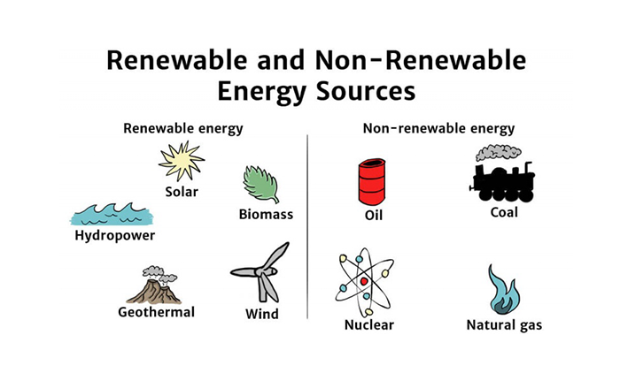
Environment
Sustainable materials
A sustainable material can be regrown replaced, or recycled whilst having less impact on the environment.
Finite vs. Renewable resources
A Finite resource is a none renewable resource, such as metal ore. This must be mined responsibly as it can not be replaced quickly. Finite resources form over a long period of time (beyond a human lifetime), whereas Renewable resources can be produced quicker. An example of Renewable resources include wood as a new tree can be planted as soon as one is cut down.
Using renewable resources will likely create less pollution therefore minimalizing the effect on the environment at the end a products lifespan.

Slide 28
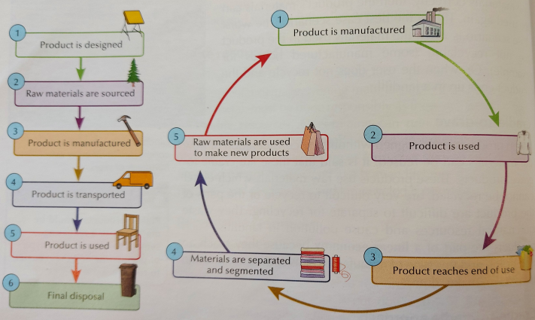
Environment
Recycling materials
  Assuming that all materials used in a product are recyclable and can be easily separated the products materials can be used again. This is the best case scenario as the product will end up in landfill otherwise.
Cradle-to-grave
  Is when products are designed without any consideration of how the materials can be reused. These products have materials that can not be recycled or are difficult to recycle. Again, these products end up in landfill.
Cradle-to cradle
  This process is described as being in harmony with the Earth. This can be done by designing products for disassembly/separation of materials so they can be reused, reprocessed or recycled.

Slide 29
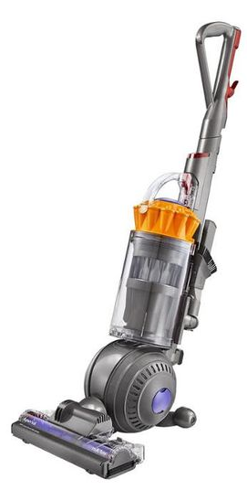
DESIGN ANALYSIS
Study the image of the Dyson vacuum cleaner and consider what you might write in your analysis of each design factor:
Function
Aesthetics
Ergonomics
Performance
Market
Environment
Safety

Slide 30
Material
Fitness for
Purpose (what it’s
designed to do
Primary
Secondary
Aesthetics
Manufacture Method
Cost
Strength
Shape
Colour
Texture
Pattern
Form
Proportion
Function
Environment
Recycling
Environmental Impact
Energy
Waste
Design Factors
Ergonomics
Physiology
Psychology
Anthropometrics
Performance
Durability (life expectancy)
Ease of Maintenance
Ease of Use
Safety
Market
e.g. no sharp edges
Who will be
buying the product

